Slide 1
Podcasting
Episcopal Communicator’s Conference
Tuesday, August 4, 2020 | 1-2pm ET
Notes:
[Kendall] – Welcome…. We’re so glad you’re here for today’s webinar, Episcopal Action on Asylum. This is the third in a three-part series called Love God, Love Neighbor: Episcopal Month of Action.
We will quickly go over some technology housekeeping before we introduce today’s presenters and panelists.

Slide 2
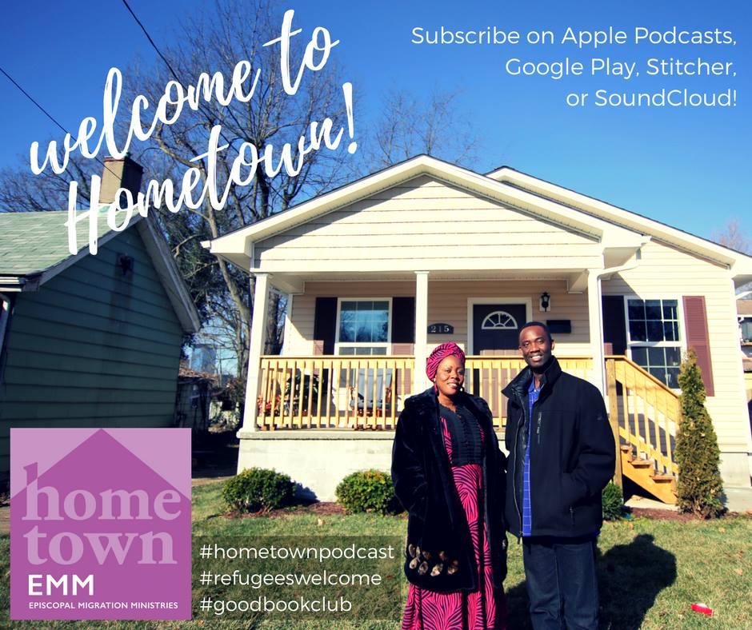
Agenda
Intro to EMM
Podcast 101
Who is listening?
Churches and Nonprofits
Getting Started: Questions to Ask
What do I need?
Process
Recommended Resources
Q & A
Notes:
Allison – Agenda

Slide 3
Educate
Congregations and communities on the global displacement crisis and how to join in welcoming work, neighbor to neighbor.​
Advocate
For the rights of and protections for refugees, immigrants, asylum seekers, victims of trafficking, and other displaced persons; equip Episcopalians to be advocates, too​
Participate
In local and global ministries to sojourners, from resettling refugees in the U.S. and networking a variety of immigration-related ministries at home, to supporting and collaborating across the Anglican Communion, and empowering Episcopalians to join in this work.
Notes:
4:01pm ET Housekeeping [Kendall]
Review Housekeeping slide

Slide 4
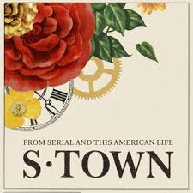
Podcast 101
Podcasting was developed in 2004 (iPod + Broadcasting)
iPodder – a program developed to download radio broadcasts directly to an iPod
Internet Radio on demand
Podcasts are free from government regulation.
You don’t need a license to broadcast.
Copyright law does apply to podcasts.
There are more than 250 audio file types available.
Podcasts can be delivered to multiple distribution points or applications through RSS (Real Simple Syndication).
Notes:
MC speak and then toss to Rushad to talk about SCOTUS decision on DACA and advocacy for DREAM Act

Slide 5
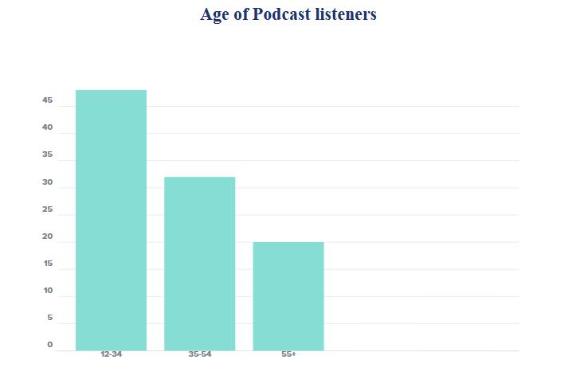
Who is listening?
Over one million podcasts
Over 29 million episodes
50% of U.S. homes are podcast fans
55% of the U.S. population has listened to a podcast.
49% of podcast listening is done at home
80% listen to all or most of each episode.
Comedy is the most popular podcasting genre, followed by education and news.
Edison Research Infinite Dial - 2020
Notes:
MC speak and then toss to Rushad to talk about SCOTUS decision on DACA and advocacy for DREAM Act

Slide 6
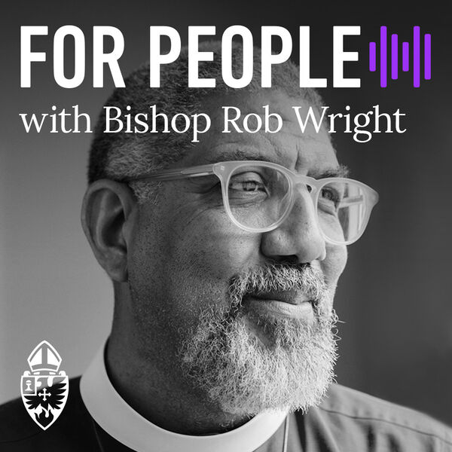
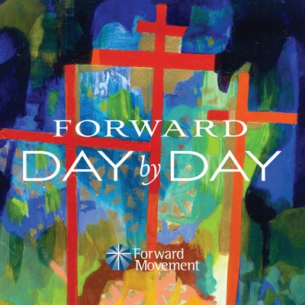
Why do churches and nonprofits have podcasts?
Connection
Community
Meet people where they are.
Accessibility
Convenience
We are hard-wired for stories.
Notes:
MC speak and then toss to Rushad to talk about SCOTUS decision on DACA and advocacy for DREAM Act

Slide 7
Getting Started: Questions to Ask
Why do we want to do a podcast?
Who is our audience?
What value do we bring?
What is our budget?
What format will we use?
How much time do we have for recording, editing, and posting content?
Notes:
MC speak and then toss to Rushad to talk about SCOTUS decision on DACA and advocacy for DREAM Act

Slide 8
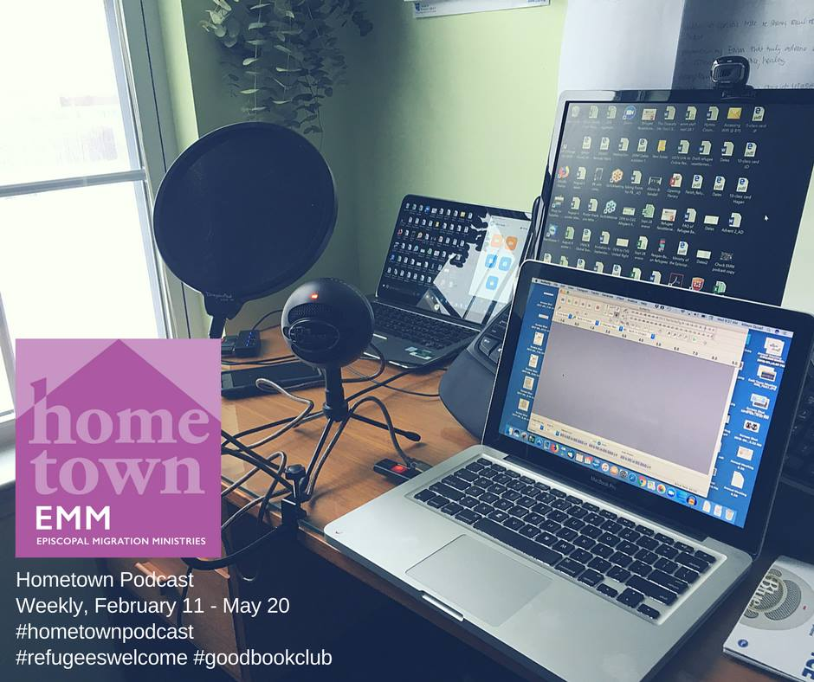
What Do I Need?
Software
Zoom/Skype
Zencastr/Ringr
Squadcast
Alitu
Audacity
Garageband
Equipment
Computer
Handheld Recorder
Microphone/Pop Filter
Headphones
Brand
Logo
Tagline/Description
Theme song
Category
Consistent style
Webpage/Website
A Plan
Location
Schedule
Editing process
Host/Pod directories
Notes:
MC speak and then toss to Rushad to talk about SCOTUS decision on DACA and advocacy for DREAM Act

Slide 9
Process
Brainstorm content, assign roles
Create schedule (include topic, guests, record date, publish date)
Invite guests/complete background research
Schedule recording platform/send advice on recording sound to any guests/send preliminary questions to any guests
Finalize script bullet points/questions, write intro/outro (if not static)
Record podcast (daily: 15-20mins, weekly: max of 60 mins, monthly: max of 90 mins)
Edit podcast (Allow a couple of hours depending on quality of recording)/ create social media graphics for episode/write blog content
Upload final audio file to host platform (ex: SoundCloud)
Share podcast episode via social media, website, newsletters
Notes:
MC speak and then toss to Rushad to talk about SCOTUS decision on DACA and advocacy for DREAM Act

Slide 10
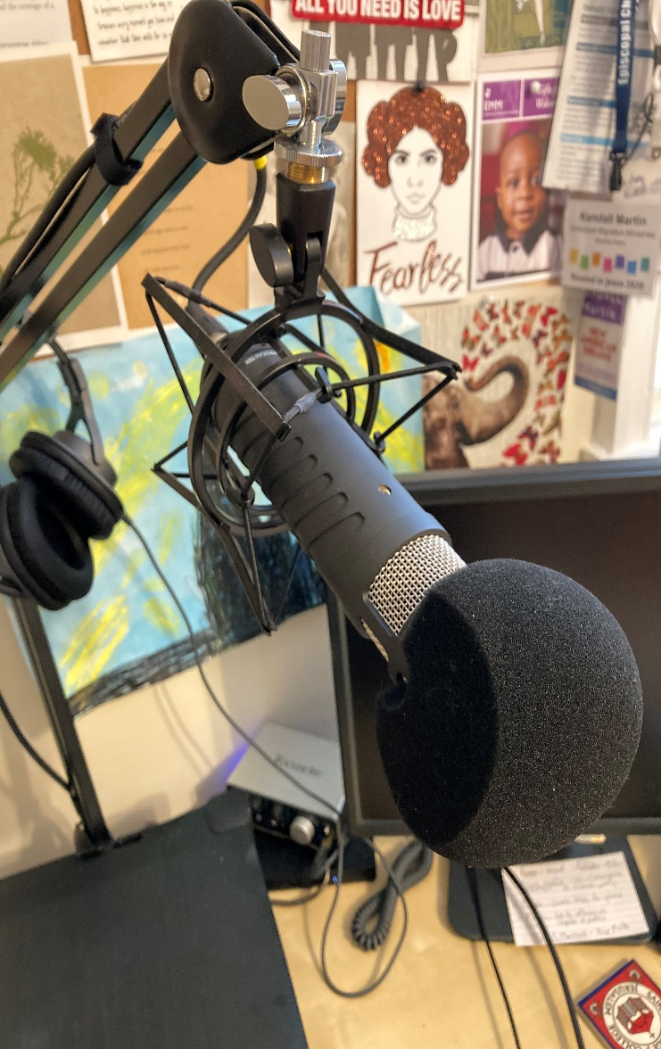
Recommended Products & Resources
Gear:
Low-end microphone: Snowball plus pop filter
High-end microphone: Rode Procaster Broadcast Dynamic Vocal Microphone with Rode Studio Microphone Boom Arm and Rode Shock Mount
Low-end “traveling” recorder: Smartphone with plug-in mic
High-end “traveling” recording: Zoom H5 Four-Track Portable Recorder
Headphones: Studio Monitoring (Bose, Audio-Technica, Shure)
Recording:
Squadcast
Zencastr
Zoom/Skype
Editing:
Audacity
Garageband
Alitu
Notes:
[Rushad]

Slide 11
Recommended Products & Resources
Music:
Incompetech.com
Audiojungle.net
Freemusicarchive.com
Themesong.studio
Channels:
SoundCloud
iTunes
Spotify
Google Play
Stitcher
Notes:
[Rushad]

Slide 12
Q&A
Notes:
Allison:

Slide 13
Episcopal Migration Ministries
episcopalmigrationministries.org
Social Media: @EMMRefugees
Subscribe to Hometown on Apple Podcasts, Google Play, Stitcher, SoundCloud, and Spotify.
Contact:
Kendall Martin, kmartin@episcopalchurch.org
Allison Duvall, aduvall@episcopalchurch.org
Thank you for joining us!

